Slide 1
MODULE 3 PROBLEM SOLVING
Refer Chapter 3 & 4

Slide 3
Solving problem by SEARCHING
An agent can ﬁnd a sequence of actions that achieves its goals when no single action will do.
Problem solving begins with precise deﬁnitions of PROBLEMS AND THEIR SOLUTIONS
Uninformed search algorithms—algorithms that are given no information about the problem other than its deﬁnition
Informed search algorithms—Can work well given some guidance on where to look for solutions.

Slide 4
Search Algorithm Terminologies
Search: Searching is a step by step procedure to solve a search-problem in a given search space.
A search problem can have three main factors:
Search Space: Search space represents a set of possible solutions, which a system may have.
Start State: It is a state from where agent begins the search.
Goal test: It is a function which observe the current state and returns whether the goal state is achieved or not.
Search tree: A tree representation of search problem is called Search tree.
Actions: It gives the description of all the available actions to the agent.
Transition model: Representation of description of what each action does.
Path Cost: It is a function which assigns a numeric cost to each path.
Solution: It is an action sequence which leads from the start node to the goal node.
Optimal Solution: If a solution has the lowest cost among all solutions.

Slide 5
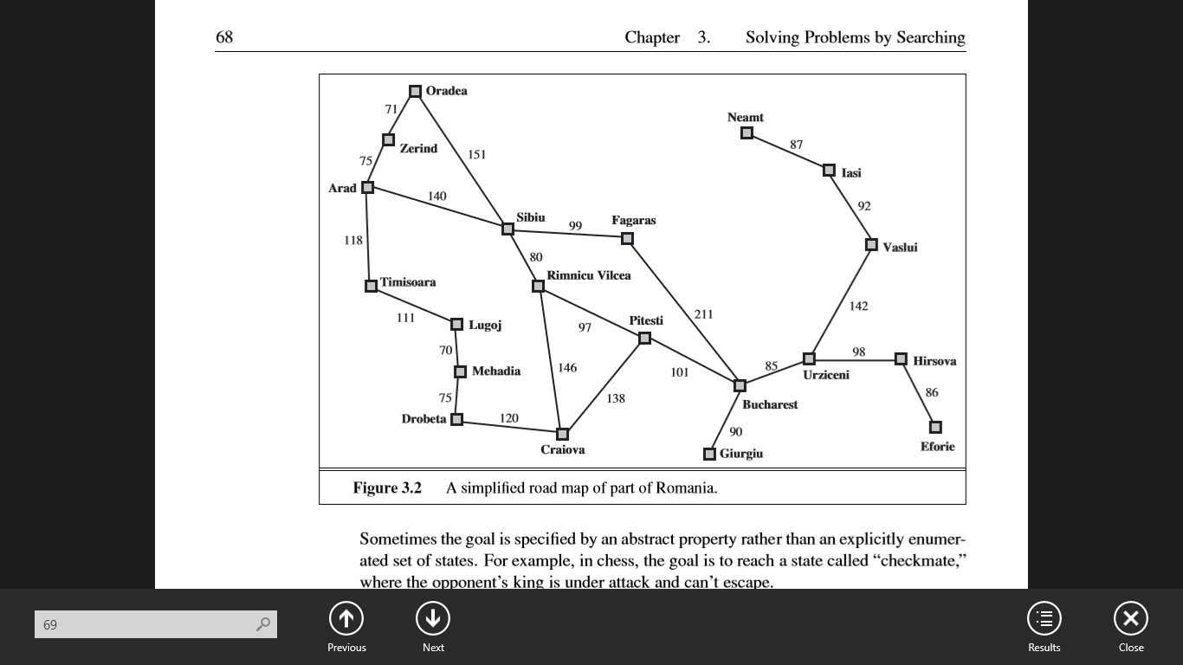

Slide 6
PROBLEM-SOLVING AGENTS
Ex:- (Imagine an agent in the city of Arad-Romania, enjoying a touring holiday- AGENT’s PERFORMANCE MEASURE?
[then Bucharest- Flight Ticket )).
Parking lot-left right ,by an inch,etc.
GOAL FORMULATION:- Based on the current situation and the agent’s performance measure.
PROBLEM FORMULATION:- Process of deciding what actions and states to consider, given a GOAL.
The agent will consider actions at the level of driving from one major town to another.
Each state therefore corresponds to being in a particular town.

Slide 7
“An agent with several immediate options of unknown value can decide what to do by ﬁrst examining future actions that eventually lead to states of known value”
i.e Assumption of Environment: Observable , Discrete(finite) , Known , Deterministic
Process of looking for a sequence of actions that reaches the goal is called search.
SEARCH ALGORITHM takes a problem as input and returns a solution in the form of an action sequence.
EXECUTION PHASE: Once a solution is found, the actions it recommends can be carried out. “FORMULATE, SEARCH, EXECUTE” design for the agent

Slide 8
Formulating problems
Formulation seems reasonable, but it is still a model—an abstract mathematical description
Compare the simple state description chosen,
In(Arad), to an actual cross- country trip, where the state of the world includes so many things:
the traveling companions,
the current radio program,
the scenery out of the window,
the proximity of law enforcement ofﬁcers,
the distance to the next rest stop,
the condition of the road,
the weather, and so on.
ABSTRACTION of STATE DESCRIPTION : The process of removing detail

Slide 9
Abstract the actions themselves.
A driving action has many effects.
Besides changing the location of the vehicle and its occupants, it takes up time, consumes fuel, generates pollution, and changes the agent
Ex: Path from Arad to Sibiu to Rimnicu Vilcea to Pitesti to Bucharest
Good abstraction:- Removing as much detail as possible while retaining validity and ensuring that the abstract actions are easy to carry out

Slide 10
EXAMPLE PROBLEMS (Toy and real-world problems)
A TOY PROBLEM is intended to illustrate or exercise various problem-solving methods given a concise, exact description and hence is usable by different researchers to compare the performance of algorithms.
REAL-WORLD PROBLEM is one whose solutions people actually care about.

Slide 11
Example Problems
Toy problems
Illustrate/test various problem-solving methods
Concise, exact description
Can be used to compare performance
EXAMPLES: 8-puzzle, 8-queens problem, Cryptarithmetic, Vacuum world, Missionaries and cannibals, simple route finding
Real-world problem
More difficult
No single, agreed-upon specification (state, successor function, edge cost)
Examples: Route finding, VLSI layout, Robot navigation, Assembly sequencing

Slide 12
STATE SPACE REPRESENTATION
A problem can be deﬁned formally by ﬁve components:
INITIAL STATE that the agent starts in.
Description of the POSSIBLE ACTIONS available to the agent.
DESCRIPTION of what each action does. [transition model]
GOAL TEST, which determines whether a given state is a goal state
PATH COST FUNCTION that assigns a numeric cost to each path
A SOLUTION TO A PROBLEM IS AN ACTION SEQUENCE THAT LEADS FROM THE INITIAL STATE TO A GOAL STATE.
Note: Solution quality = path cost function, & OPTIMAL SOLUTION →lowest path cost among all solutions

Slide 13
EXAMPLE 1

Slide 14
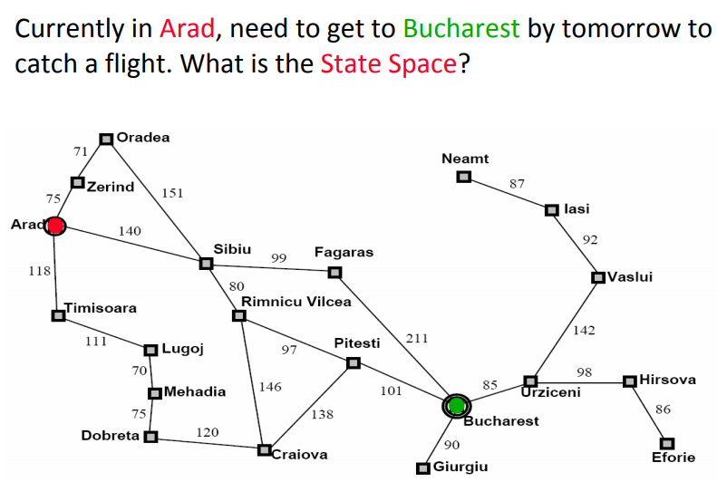

Slide 15
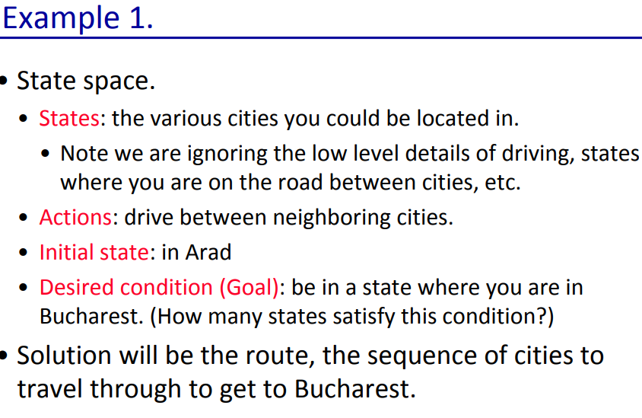

Slide 16
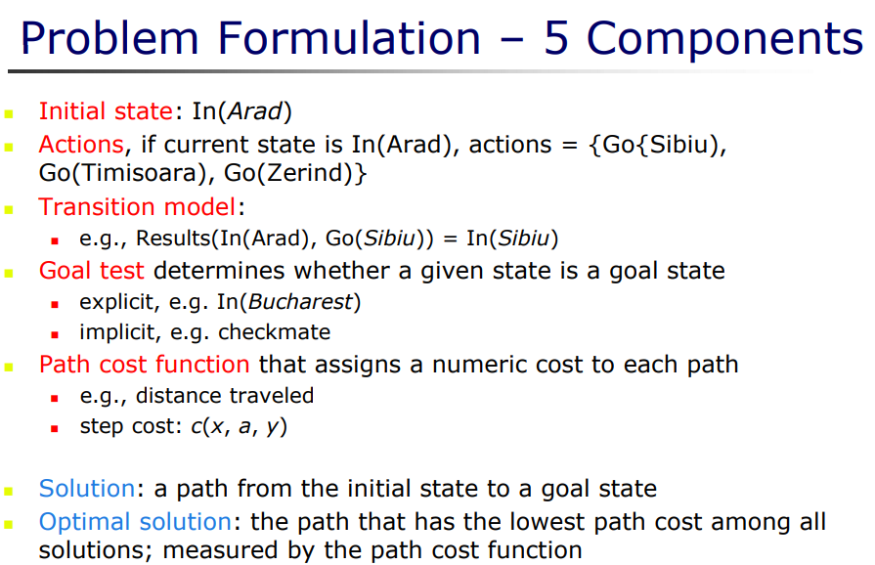

Slide 17
Example 2

Slide 18
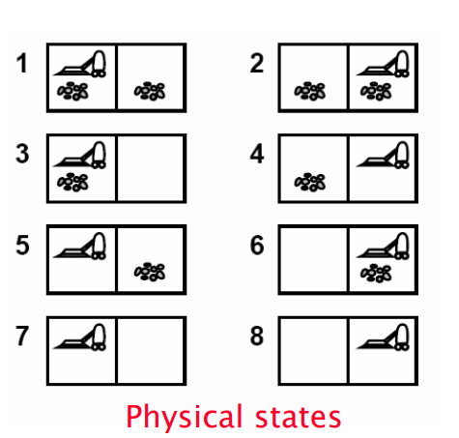
Vacuum Cleaner
The vacuum world
The world has only two locations
Each location may or may not contain dirt
The agent may be in one location or the other
8 possible world states
Three possible actions: Left, Right, Suction
Goal: clean up all the dirt

Slide 19
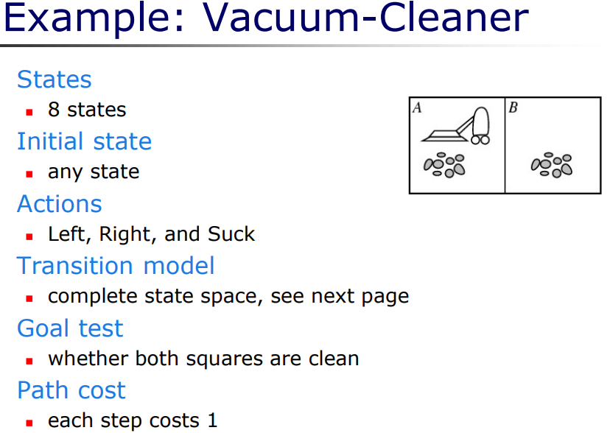

Slide 20
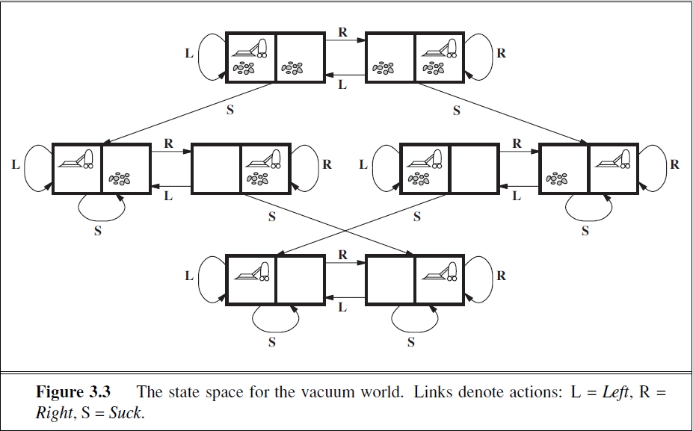

Slide 21
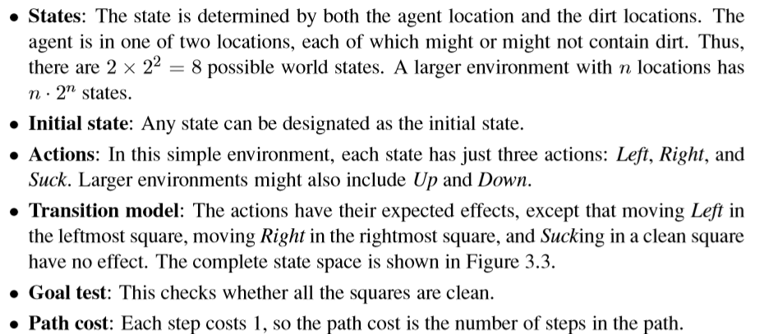
Formulating a Vacuum Agent

Slide 22
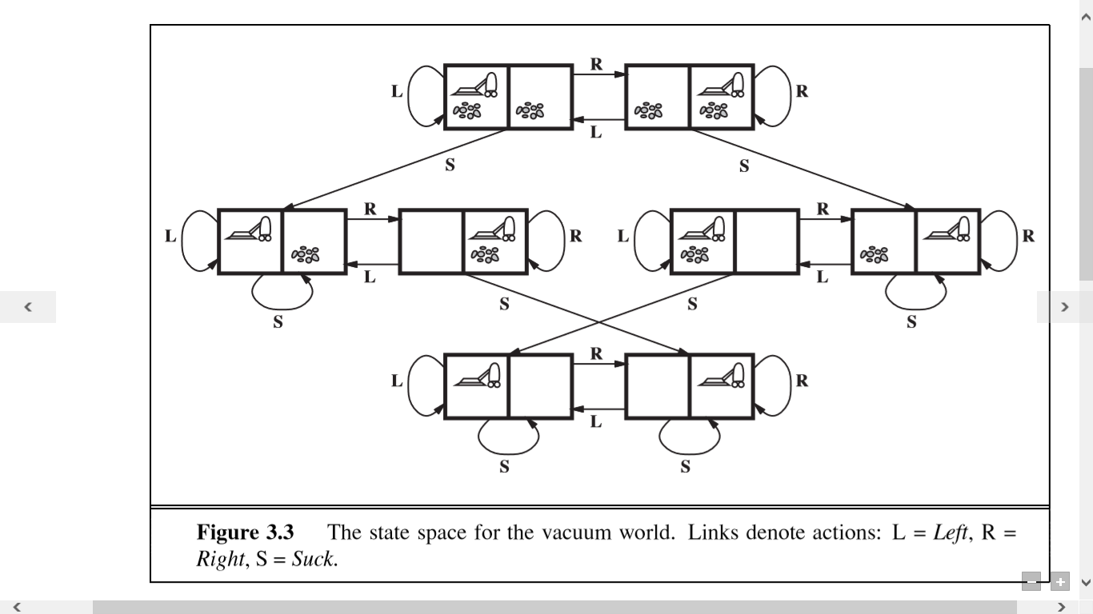

Slide 23
Example 3

Slide 24
Missionaries and Cannibals
Question: In this problem, three missionaries and three cannibals must cross a river using a boat which can carry at most two people, under the constraint that, for both banks, that the missionaries present on the bank cannot be outnumbered by cannibals. The boat cannot cross the river by itself with no people on board.
Short Video

Slide 25
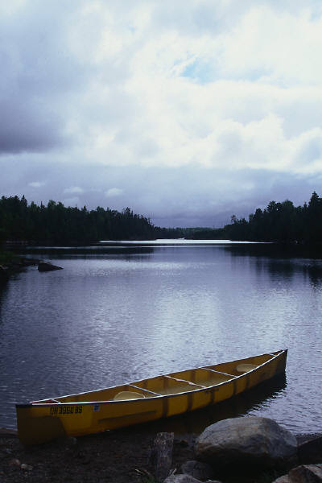
Missionaries and cannibals
There are three missionaries and three cannibals on the left bank of a river.
They wish to cross over to the right bank using a boat that can only carry two at a time.
The number of cannibals on either bank must never exceed the number of missionaries on the same bank, otherwise the missionaries will become the cannibals' dinner!
Plan a sequence of crossings that will take everyone safely across.

Slide 26
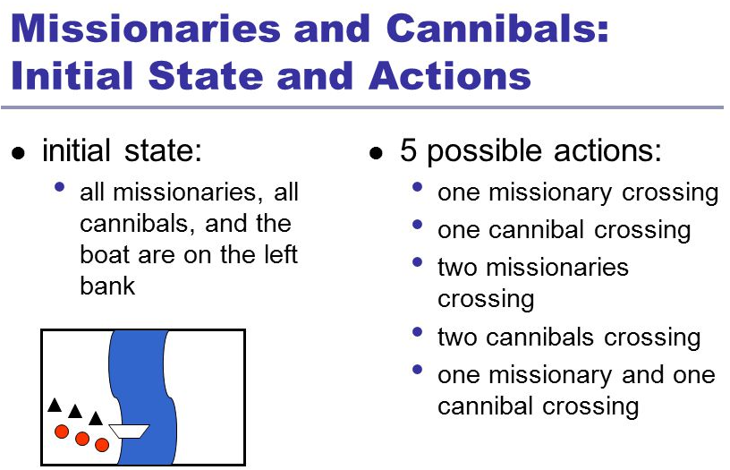

Slide 27
Solution
First let us consider that both the missionaries (M) and cannibals(C) are on the same side of the river- Left Right Initially the positions are : 0M , 0C and 3M , 3C (B)
Now let’s send 2 Cannibals to left of bank : 0M , 2C (B) and 3M , 1C
Send one cannibal from left to right : 0M , 1C and 3M , 2C (B)
Now send the 2 remaining Cannibals to left : 0M , 3C (B) and 3M , 0C Send 1 cannibal to the right : 0M , 2C and 3M , 1C (B)
Now send 2 missionaries to the left : 2M , 2C (B) and 1M . 1C
Send 1 missionary and 1 cannibal to right : 1M , 1C and 2M , 2C (B)
Send 2 missionaries to left : 3M , 1C (B) and 0M , 2C
Send 1 cannibal to right : 3M , 0C and 0M , 3C (B)
Send 2 cannibals to left : 3M , 2C (B) and 0M , 1C
Send 1 cannibal to right : 3M , 1C and 0M , 2C (B)’
Send 2 cannibals to left : 3M , 3C (B) and 0M , 0C
Here (B) shows the position of the boat after the action is performed. Therefore all the missionaries and cannibals have crossed the river safely.

Slide 28
Formulating Missionaries & Cannibal Problem
State space: Triple (x , y , z ) with 0 ≤ x , y , z ≤ 3, where x , y , and z represent the number of missionaries, cannibals and boats currently on the original bank.
Initial State: ( 3 , 3 , 1 )
Successor function: From each state, either bring
one missionary, one cannibal,
two missionaries, two cannibals, or
one of each type to the other bank.
Note: Not all states are attainable (e.g., (0,0,1)), and some are illegal.
Goal State: (0,0,0)
Path Costs: 1 unit per crossing

Slide 29
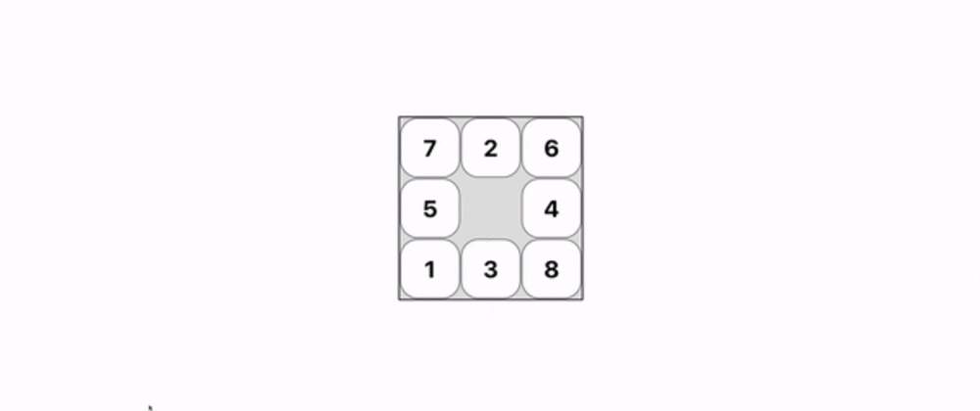
Example 4

Slide 30
The 8 Puzzle
Sliding-block/tile-puzzle(most popular instruments in AI studies) [toy-problem]
Arrange the tiles so that all the tiles are in the correct positions.
You can move the BLANK tile up, down, left, or right, so long as the following conditions are met:
There’s no other tile blocking you in the direction of the movement;
You are not trying to move outside of the boundaries/edges.

Slide 31
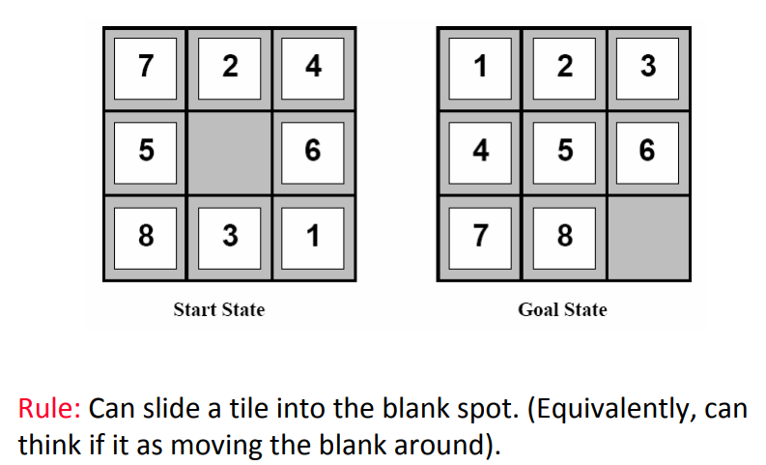
8-puzzle

Slide 32
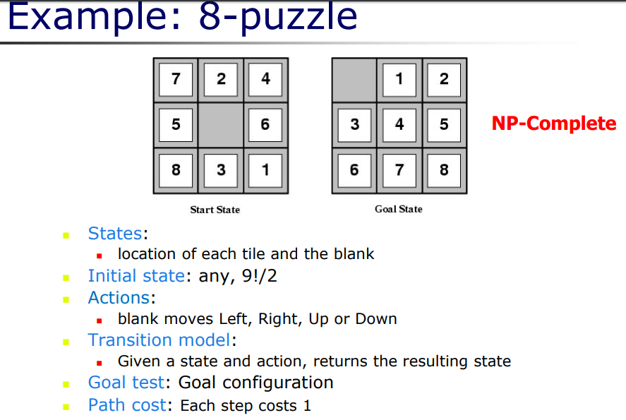

Slide 33
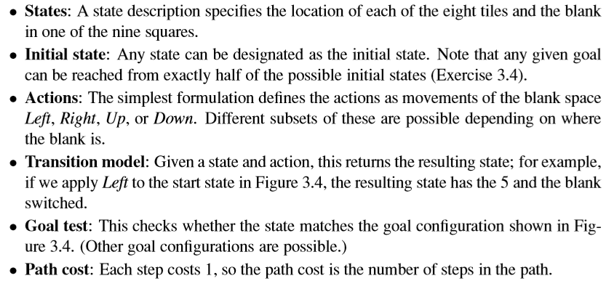
Formulating for 8 puzzle problem

Slide 34
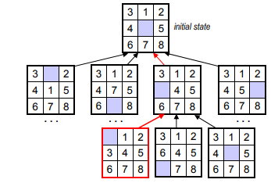

Slide 35
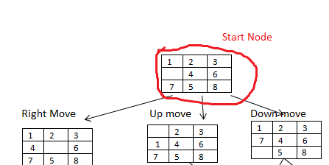
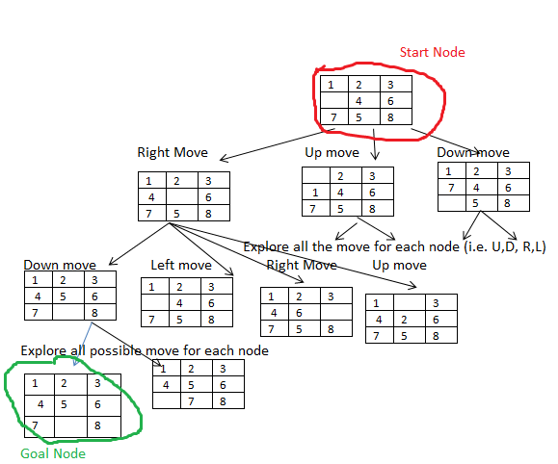
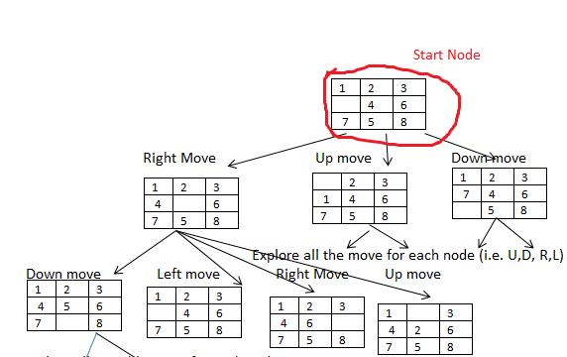
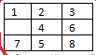
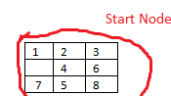

Slide 36
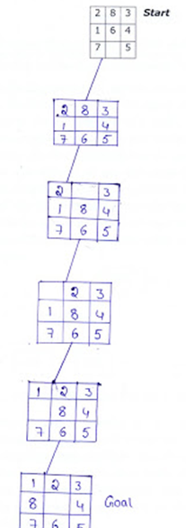
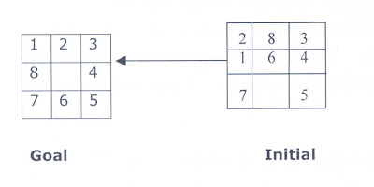

Slide 37
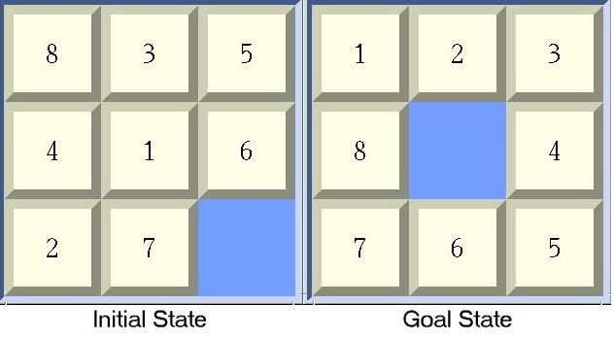

Slide 38
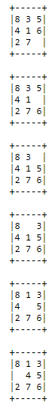
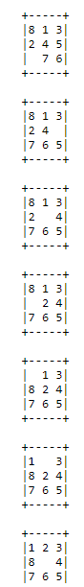

Slide 39
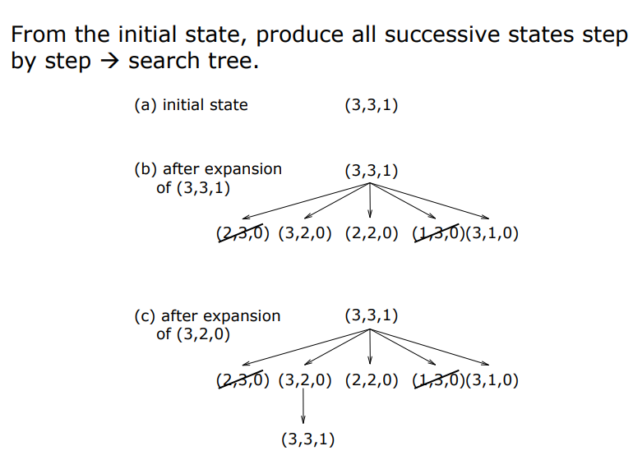

Slide 40
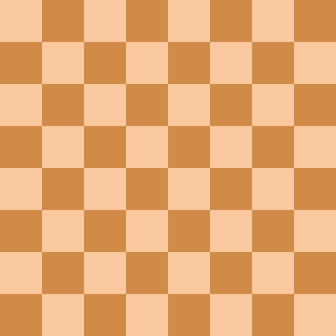
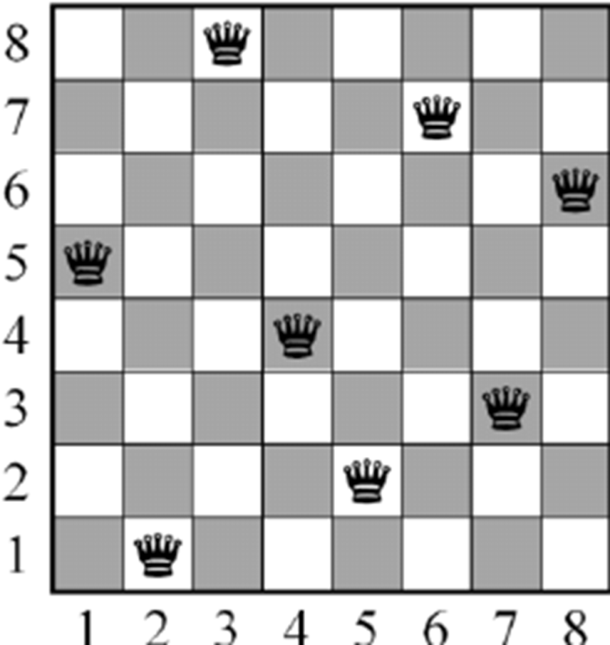
Example 5

Slide 41
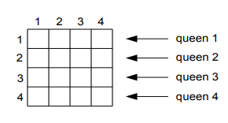
4 Queen Problem
THE N-QUEEN PROBLEM: Place n queens on an n by n chess board so that no two of them are on the same row, column, or diagonal .

Slide 42
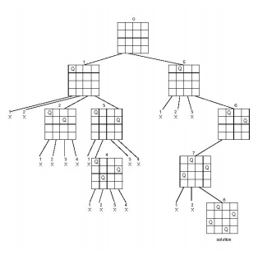

Slide 43
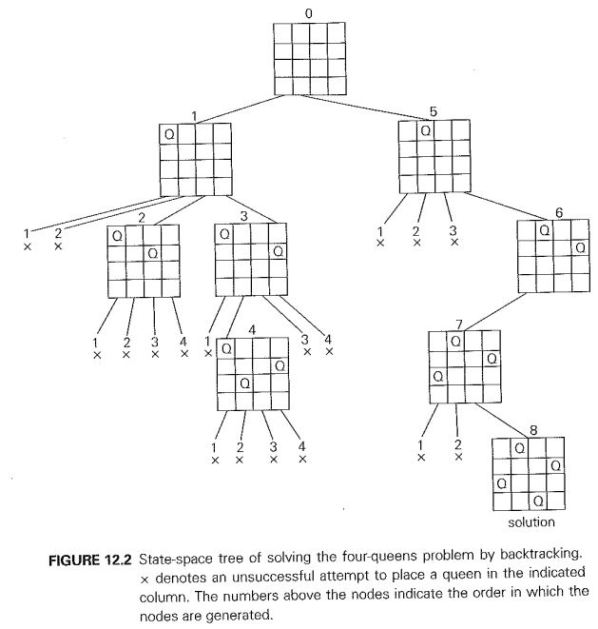
4 Queen

Slide 44
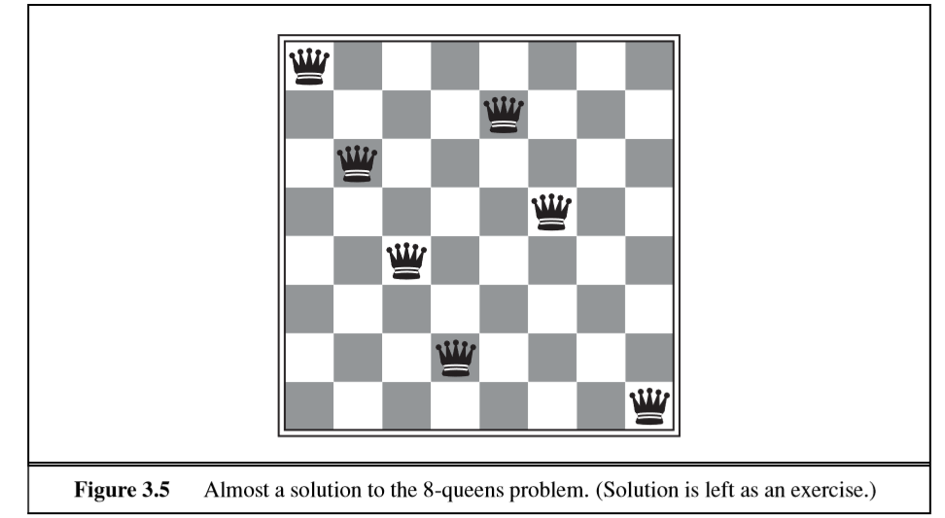
8-queens problem The goal of the 8-queens problem is to place eight queens on a chessboard such that no queen attacks any other. (A queen attacks any piece in the same row, column or diagonal.)

Slide 45
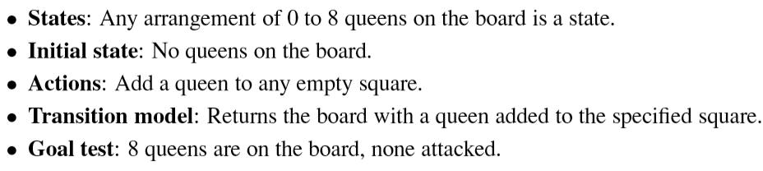
Formulating 8 Queens Problem

Slide 46
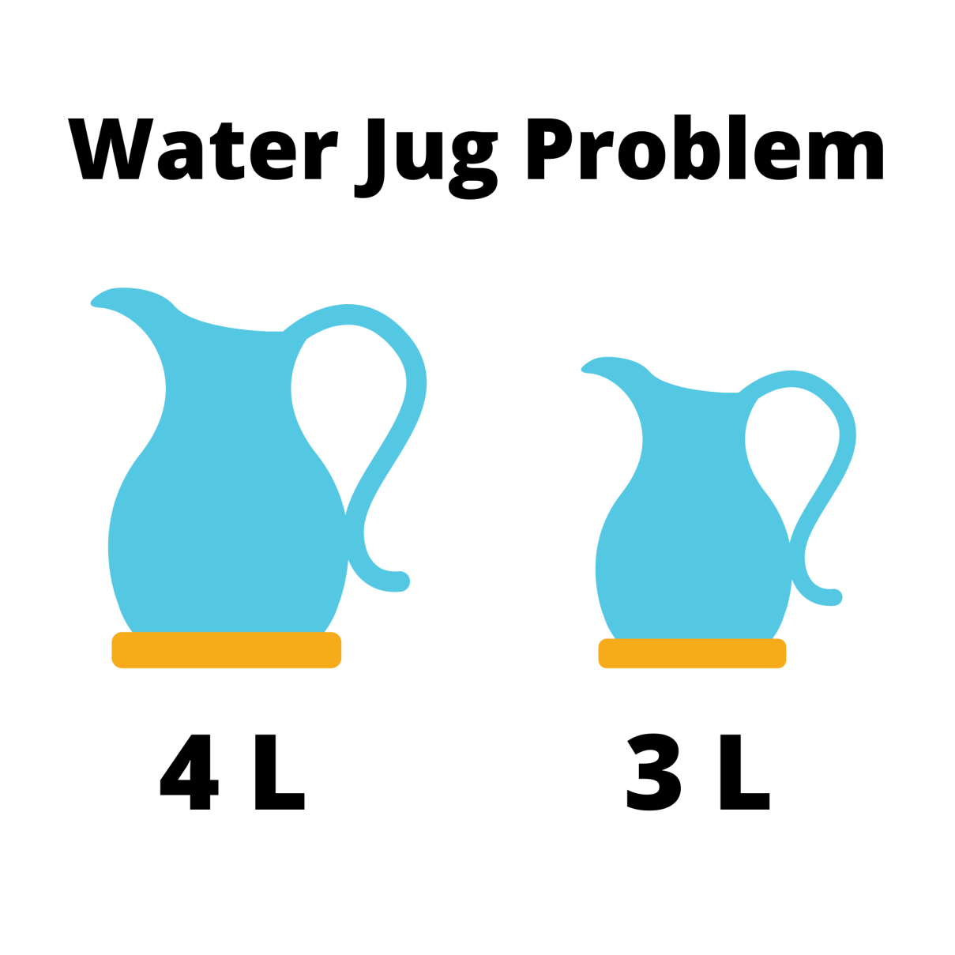
Example 6

Slide 47
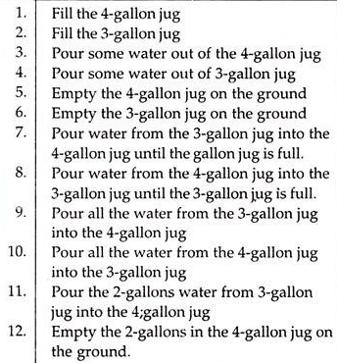
Water Jug Problem
Problem: You are given two jugs, a 4-gallon one and a 3-gallon one . Neither has any measuring mark on it . There is a pump that can be used to fill the jugs with water . How can you get exactly 2 gallons of water into the 4-gallon jug.

Slide 48
X is 4L and Y is 3L
X = 0 , Y = 3 .
X = 3 , Y = 0 . (Transfer Y to X )
X = 3 , Y = 3 .( Capacity of X being 4)
X =4 , Y = 2 . (Fill X up to brim )
X=2 , Y= 0 . (Fill X with contents of Y after emptying X)

Slide 49
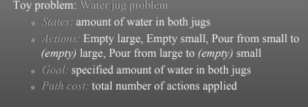
Formulating Water Jug Problem

Slide 50
REAL WORLD PROBLEMS
Web sites and in-car systems that provide driving directions
Touring Problems
Travelling Salesman Problem
Robot Navigation
Others, such as
routing video streams in computer networks
military operations planning
airline travel planning systems
CONSIDER THE AIRLINE TRAVEL PROBLEMS THAT MUST BE SOLVED BY A TRAVEL-PLANNING WEB SITE

Slide 51
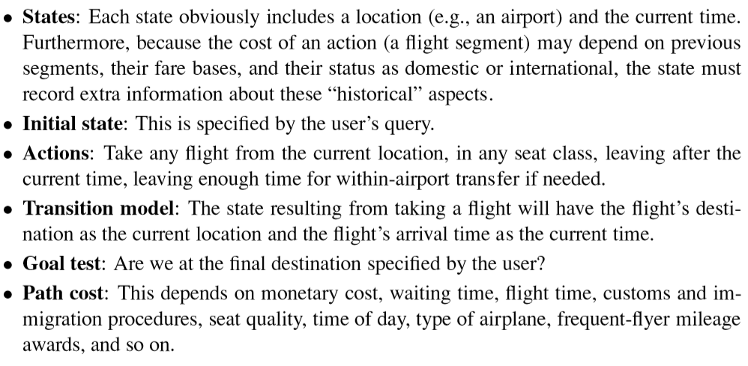

Slide 52
A VLSI layout problem requires positioning millions of components and connections on a chip to minimize area, minimize circuit delays, minimize stray capacitances, and maximize manufacturing yield.
PROTEIN DESIGN in which the goal is to ﬁnd a sequence of amino acids that will fold into a three-dimensional protein with the right properties to cure some disease.

Slide 53
Defining Problem as a STATE SPACE SEARCH
A state space that contains all possible configurations of all relevant objects.
Specify one or more states describing all possible situations from which problem solving may start (Initial States)
Specify one or more states that would be acceptable as solutions to problems (Goal States).
Specify set of rules that describe actions (operators) available.
What unstated assumptions are present in the informal problem description?
How general should the rules be ?
How much of the work required to solve the problem should be pre computed and represented in the rules?

Slide 54
Production Systems
A set of rules(Left side[pattern] determining applicability of rule on right side[describes operation to be performed if rule applied])
One or more knowledge base (Structured)
Control strategy-order of rules applied/compared , way of resolving conflicts.
A rule applier

Slide 55
S.No. | Initial State | Condition | Final state | Description of action taken
1. | (x,y) | If x<4 | (4,y) | Fill the 4 gallon jug completely
2. | (x,y) | if y<3 | (x,3) | Fill the 3 gallon jug completely
3. | (x,y) | If x>0 | (x-d,y) | Pour some part from the 4 gallon jug
4. | (x,y) | If y>0 | (x,y-d) | Pour some part from the 3 gallon jug
5. | (x,y) | If x>0 | (0,y) | Empty the 4 gallon jug

Slide 56
S.No. | Initial State | Condition | Final state | Description of action taken
6. | (x,y) | If y>0 | (x,0) | Empty the 3 gallon jug
7. | (x,y) | If (x+y)<7 | (4, y-[4-x]) | Pour some water from the 3 gallon jug to fill the four gallon jug
8. | (x,y) | If (x+y)<7 | (x-[3-y],3) | Pour some water from the 4 gallon jug to fill the 3 gallon jug.
9. | (x,y) | If (x+y)<4 | (x+y,0) | Pour all water from 3 gallon jug to the 4 gallon jug
10. | (x,y) | if (x+y)<3 | (0, x+y) | Pour all water from the 4 gallon jug to the 3 gallon jug

Slide 57
S.No. | Initial State | Condition | Final state | Description of action taken
1. | (x,y) | If x<4 | (4,y) | Fill the 4 gallon jug completely
2. | (x,y) | if y<3 | (x,3) | Fill the 3 gallon jug completely
3. | (x,y) | If x>0 | (x-d,y) | Pour some part from the 4 gallon jug
4. | (x,y) | If y>0 | (x,y-d) | Pour some part from the 3 gallon jug
5. | (x,y) | If x>0 | (0,y) | Empty the 4 gallon jug
6. | (x,y) | If y>0 | (x,0) | Empty the 3 gallon jug
7. | (x,y) | If (x+y)<7 | (4, y-[4-x]) | Pour some water from the 3 gallon jug to fill the four gallon jug
8. | (x,y) | If (x+y)<7 | (x-[3-y],3) | Pour some water from the 4 gallon jug to fill the 3 gallon jug.
9. | (x,y) | If (x+y)<4 | (x+y,0) | Pour all water from 3 gallon jug to the 4 gallon jug
10. | (x,y) | if (x+y)<3 | (0, x+y) | Pour all water from the 4 gallon jug to the 3 gallon jug

Slide 58
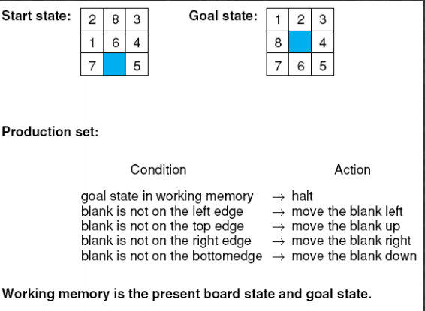
8 puzzle problem

Slide 59
Problem Characteristics
Is the problem decomposable? Sub goal
Can solution steps be ignored or undone ?Eg (8 puzzle ,Chess , Theorem Proving)
Ignorable , Recoverable , Irrecoverable (3 classes of problems).
Is the universe predictable?(Plan Problem Solving?) Eg Lawyer,Controlling Robot arm…
Is a Good solution Absolute or relative? Good Heuristics play imp role.
Is the Solution a state or a path?
What is the role of knowledge? Eg Chess-Strategy and Tactics, Newspaper reading?
Does the task require interaction with a person? Solitary and Conversational. Eg Medical diagnosis v/s peoples reaction?
Problem Classification

Slide 60
Issues in designing of search problems
Direction of search(Forwards v/s Backward reasoning)
Selecting matching (applicable)rules.
Efficient procedures to match rules against states in production system.
Knowledge Representational Problem-representing each node of the search process-Eg Chess (Array[small] v/s ??)

Slide 61
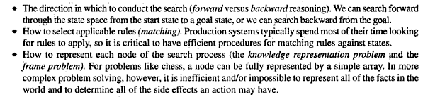
Issues in designing of search problems

Slide 62
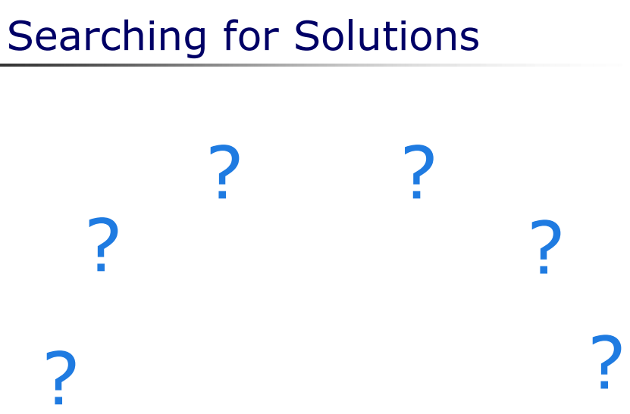

Slide 63
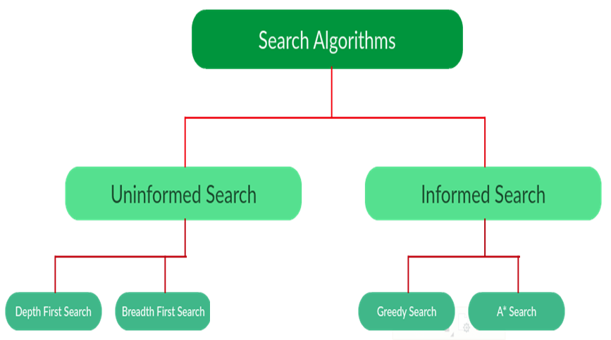
Depth Limited Search
AO*
Iterative deepening Depth First Search

Slide 64
UNINFORMED SEARCH STRATEGIES(blind search)
“Strategies have no additional information about states beyond that provided in the problem deﬁnition”
All they can do is generate successors and distinguish a goal state from a non-goal state.
Breadth-ﬁrst search (BFS)
Depth-ﬁrst search (DFS)
Depth Limited search(DLS)
Iterative Deepening depth first search(IDDS)

Slide 65
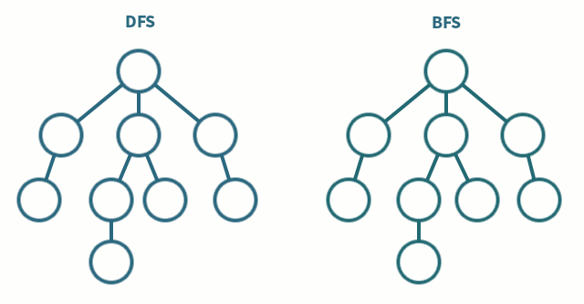

Slide 66
BREADTH FIRST SEARCH
Breadth-ﬁrst search is a simple strategy in which the root node is expanded ﬁrst, then all the successors of the root node are expanded next, then their successors, and so on.

Slide 67
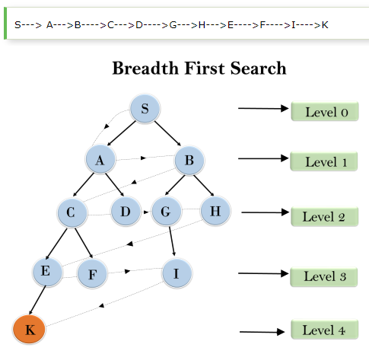

Slide 68
ADVANTAGES:
BFS will provide a solution if any solution exists.
If there are more than one solutions for a given problem, then BFS will provide the minimal solution which requires the least number of steps.
DISADVANTAGES:
It requires lots of memory since each level of the tree must be saved into memory to expand the next level.
BFS needs lots of time if the solution is far away from the root node.

Slide 69
DEPTH-FIRST SEARCH
Depth-ﬁrst search always expands the deepest node in the current frontier of the search tree.

Slide 70
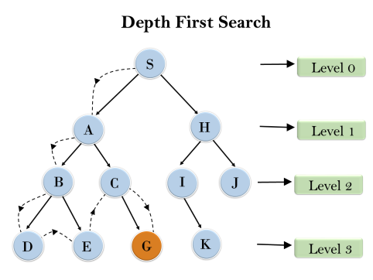
Root node--->Left node ----> right node.

Slide 71
Advantages:
DFS consumes very less memory space.
It will reach at the goal node in a less time period than BFS if it traverses in a right path.
It may find a solution without examining much of search because we may get the desired solution in the very first go.

Slide 72
Disadvantages
This algorithm may not terminate and go on infinitely on one path.
The solution to this issue is to choose a cut-off depth.
If the ideal cut-off is d, and if chosen cut-off is lesser than d, then this algorithm may fail.
If chosen cut-off is more than d, then execution time increases.
Its complexity depends on the number of paths
It cannot check duplicate nodes.

Slide 73
DEPTH LIMITED SEARCH
The embarrassing failure of depth-ﬁrst search in inﬁnite state spaces can be alleviated by supplying depth-ﬁrst search with a predetermined depth limit .
Nodes at depth are treated as if they have no successors.
This approach is called depth-limited search

Slide 74
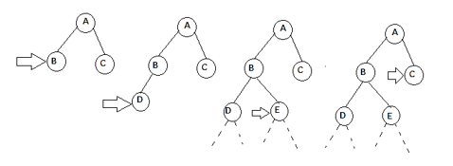
Depth-limited search can terminate with two conditions:
If the solution is found.
If there is no solution within given depth limit.
PROCESS: If depth is fixed to 2, DLS carries out depth first search till second level in the search tree.

Slide 75
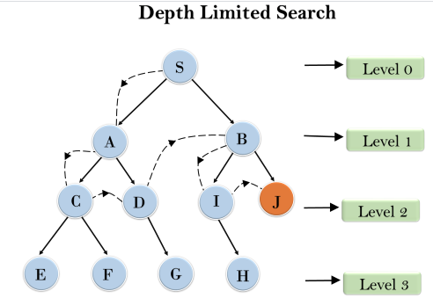

Slide 76
Advantages:
Depth-limited search is Memory efficient.
Disadvantages:
Depth-limited search also has a disadvantage of incompleteness.
It may not be optimal if the problem has more than one solution.

Slide 77
What if solution is deeper than L?
Increase L iteratively.
ITERATIVE DEEPENING SEARCH
This inherits the memory advantage of Depth-First search, and is better in terms of time complexity than Breadth first search

Slide 78
ITERATIVE DEEPENING SEARCH
Iterative deepening depth-ﬁrst search/ Iterative deepening search [depth-ﬁrst tree search that ﬁnds the best depth limit]
It does this by gradually increasing the limit—ﬁrst 0, then 1, then 2,and so on—until a goal is found.
This will occur when the depth limit reaches d, the depth of the shallowest goal node.
Iterative deepening combines the beneﬁts of depth-ﬁrst and breadth-ﬁrst search.

Slide 79
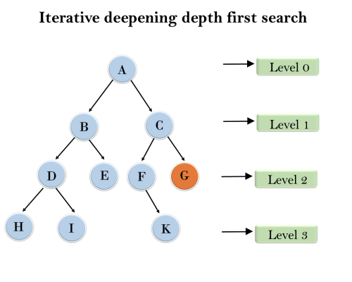
1'st Iteration-----> A 2'nd Iteration----> A, B, C 3'rd Iteration------>A, B, D, E, C, F, G

Slide 80
Advantages:
It combines the benefits of BFS and DFS search algorithm in terms of fast search and memory efficiency.
Disadvantages:
The main drawback of IDDFS is that it repeats all the work of the previous phase.

Slide 81
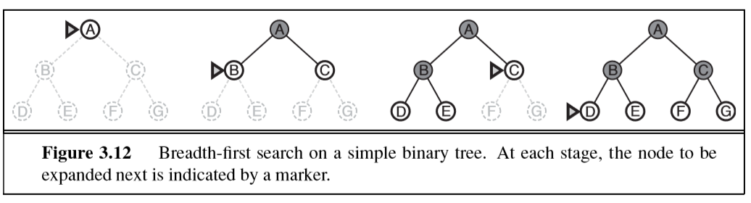

Slide 82
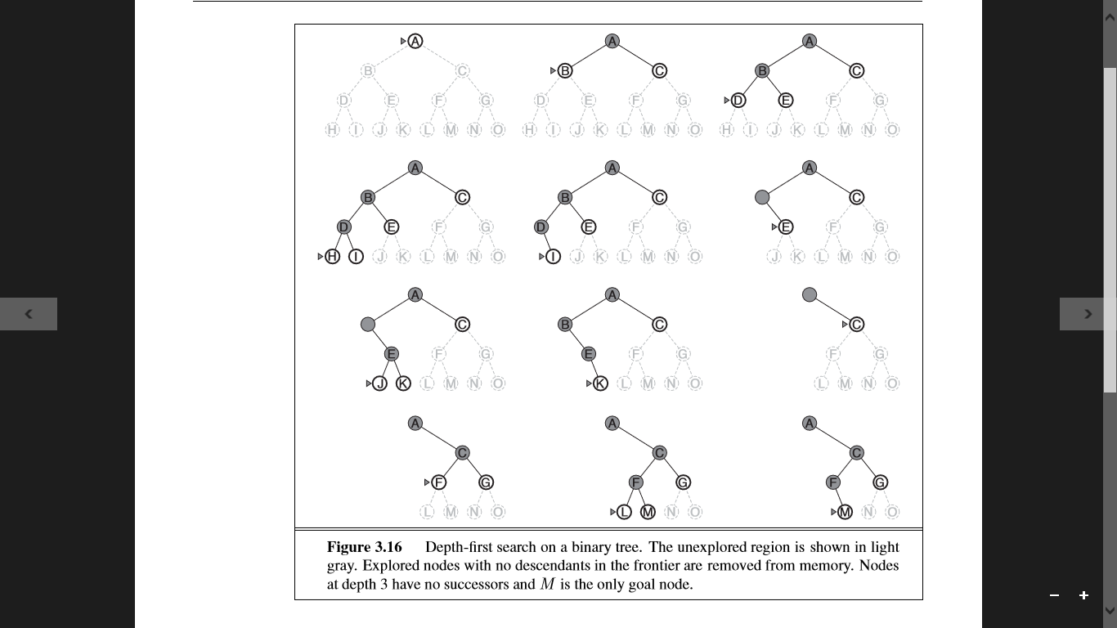

Slide 83





Slide 84


Slide 85
BFS,DFS

Slide 87


Solve for IDDS with all steps

Slide 88
BFS,DFS,DLS,IDS

Slide 90
BFS Sequence-
DFS Sequence-
DLS Sequence-
IDS Sequence-

Slide 91



Slide 92
BFS Sequence-
DFS Sequence-
DLS Sequence-
IDS Sequence-

Slide 93


Slide 94
INFORMED SEARCH
Informed search strategy
one that uses problem-speciﬁc knowledge beyond the deﬁnition of the problem itself
Find solutions more efﬁciently than an uninformed strategy.

Slide 95
BEST-FIRST SEARCH
Idea: Use an evaluation function f(n) for each node
f(n) provides an estimate for the total cost.
Expand the node n with smallest f(n).
Implementation:
Order the nodes in increasing order of cost.
SPECIAL CASES
Greedy best-first search
A* search ,AO*

Slide 96
Two list of nodes:- OPEN- nodes that have been generated but have not been visited yet or It contains the nodes that has been traversed but yet not been marked solvable or unsolvable. CLOSED- nodes that have been already visited or It contains the nodes that have already been processed.

Slide 97

OPEN →A, B ,C ,D ,E ,F ,I ,J →[B , C , F , I]
CLOSED [ A - D - E - J ]

Slide 98

Source : S
D Goal: G
The shortest path form S -> G is S -> B -> F -> G
Total cost: 1+3+1=5

Slide 99

EXAMPLE

Slide 100
GREEDY BEST-FIRST SEARCH
Greedy best-ﬁrst search tries to expand the node that is closest to the goal, on the grounds that this is likely to lead to a solution quickly.
Evaluates nodes by using heuristic function; that is, f(n)=h(n).
Algorithm is called “greedy”—at each step it tries to get as close to the goal as it can.

Slide 101
GREEDY BEST FIRST SEARCH
Expand the node closest to the goal node.
The “closeness” is estimated by a heuristic h(x) .
Heuristic function is a way to inform the search about the direction to a goal.
It provides an informed way to guess which neighbour of a node will lead to a goal.
Heuristic: A heuristic h is defined as- h(x) = Estimate of distance of node x from the goal node.
Lower the value of h(x), closer is the node from the goal.
Strategy: Expand the node closest to the goal state, i.e. expand the node with lower h value.

Slide 102


Slide 103


Slide 104

Node | Heuristic value
A | 10
B | 8
D | 3
C | 5
E | 0
A --- C ---- E

Slide 105

S----> B----->F----> G

Slide 106


Slide 107

Best First Search
A– Z – O – S – R – P – B = 575

Slide 108
Straight-line Distance as Heuristic
Straight line distances as an admissible heuristic as they will never overestimate the cost to the goal.
This is because there is no shorter distance between two cities than the straight line distance.

Slide 109



Slide 110


Slide 111


Slide 112


Slide 113


Slide 114
Advantages:
Best first search can switch between BFS and DFS by gaining the advantages of both the algorithms.
This algorithm is more efficient than BFS and DFS algorithms.
Disadvantages:
It can behave as an unguided depth-first search in the worst case scenario.
It can get stuck in a loop as DFS.
This algorithm is not optimal
Arad→Sibiu → Rimnicu Virea → Pitesti → Bucharest is shorter!

Slide 115

A ∗ SEARCH
AIM: - Minimizing the total estimated solution cost
At each point in the search space, only those node is expanded which have the lowest value of f(n), and the algorithm terminates when the goal node is found.
Most widely known form of best-ﬁrst search is called A∗ search

Slide 116
F – F is the parameter of A* which is the sum of the other parameters G and H and is the least cost from one node to the next node.
This parameter is responsible for helping us find the most optimal path from our source to destination.
G – G is the cost of moving from one node to the other node.
This parameter changes for every node as we move up to find the most optimal path.
H – H is the heuristic/estimated path between the current code to the destination node.
This cost is not actual but is, in reality, a guess cost that we use to find which could be the most optimal path between our source and destination.

Slide 117






Slide 118


Slide 119


Slide 120



Slide 121

S | 7
A | 6
B | 2
C | 1
D | 0
12

Slide 122

2

Slide 123
Initialization: {(S, 5)}
Iteration1: {(S--> A, 4), (S-->G, 10)}
Iteration2: {(S--> A-->C, 4), (S--> A-->B, 7), (S-->G, 10)}
Iteration3: {(S--> A-->C--->G, 6), (S--> A-->C--->D, 11), (S--> A-->B, 7), (S-->G, 10)}
Iteration 4 will give the final result, as S--->A--->C--->G it provides the optimal path with cost 6.

Slide 125


Slide 126


Slide 127
Advantages:
Better algorithm than other search algorithms.
Optimal and complete.
Can solve very complex problems.
Disadvantages:
It does not always produce the shortest path as it mostly based on heuristics and approximation.
Memory requirement as it keeps all generated nodes in the memory, so it is not practical for various large-scale problems.
APPLICATIONS: Traffic Navigational Sys, Underwater obstacle avoidance for unmanned surface vehicle (USV) ,Path finding technique,etc..

Slide 128

AND OR Graphs AO*
AO* is used to perform a heuristic search of an AND-OR graph.

Slide 129
AO* Algorithm
When a problem can be divided into a set of sub problems, where each sub problem can be solved separately and a combination of these will be a solution → AND-OR graphs.
AND - OR trees are used for representing the solution.
The decomposition of the problem or problem reduction generates AND arcs.

Slide 130


Slide 131









Slide 132


Slide 133


Slide 134


Slide 135


Slide 136


Slide 137



Slide 138
Conditions for optimality ADMISSIBILITY AND CONSISTENCY
1) h(n) be an admissible heuristic.
An admissible heuristic is one that never overestimates the cost to reach the goal.
g(n) is the actual cost to reach “n” along the current path, and f(n)=g(n)+h(n),
i.e f(n) never overestimates the true cost of a solution along the current path through n.
Ex: Straight line distance

Slide 140
Admissibility of the heuristic function is given as:
h(n) <= h*(n)
h(n) is heuristic cost, and
h*(n) is the estimated cost.
“Hence heuristic cost should be less than or equal to the estimated cost.”

Slide 141
Slightly stronger condition called – CONSISTENCY
heuristic h(n) is consistent if,
for every node n and every successor n’ of n
generated by any action a,
The estimated cost of reaching the goal from n is no greater than the step cost of getting to n’ plus the estimated cost of reaching the goal from n’:
h ( n ) ≤ c ( n , a , n ’ ) + h ( n ’ ) .

Slide 142

Heuristics are "rules of thumb", educated guesses, intuitive judgments or simply common sense.

Slide 143
Admissible Heuristics
Never over estimated
Guaranteed to find optimal solutions
Based on evaluation function: f’(s) = h(s) + h’(s)
h’(s): estimate of length of shortest path from s to goal state
h(s): actual length

Slide 144


Heuristics for 8 puzzle problem

Slide 145

Heuristics for 8 queen problem

Slide 146


Slide 147


Slide 148

The N Queen is the problem of placing N chess queens on an N×N chessboard so that no two queens attack each other.
For example, following is a solution for 4 Queen problem.

Slide 149
The idea is to place queens one by one in different columns, starting from the leftmost column.
When we place a queen in a column, we check for clashes with already placed queens.
In the current column, if we find a row for which there is no clash, we mark this row and column as part of the solution.
If we do not find such a row due to clashes then we backtrack and return false.

Slide 150


Slide 151



Slide 152
Monkey Banana Problem
There is a monkey at the door into a room. Inside the room at the middle a banana is hanging from the ceiling and there is box at the window which can be used by monkey to grasp the banana. Monkey is allowed following actions.
1. Walk on the floor
2. Climb the box
3. Push the box around (if it is already at the box)
4. Grasp the banana if standing on the box directly under the banana.

Slide 153



Slide 154


Slide 155


Slide 156


Slide 157
Water Jug Problem
X = 0 , Y = 3 .
X = 3 , Y = 0 . (Transfer Y to X )
X = 3 , Y = 3 .( Capacity of X being 4)
X =4 , Y = 2 . (Fill X up to brim )

Slide 158


Slide 159


Slide 160
Local Search Algorithms
Local search is a heuristic method for solving computationally hard optimization problems.
Moves from solution to solution in the space of candidate solutions (the search space) by applying local changes, until a solution deemed optimal is found or a time bound is elapsed.

Slide 161
LOCAL SEARCH ALGORITHMS
“IF THE PATH TO THE GOAL DOES NOT MATTER, WE MIGHT CONSIDER A DIFFERENT CLASS OF ALGORITHMS, ONES THAT DO NOT WORRY ABOUT PATHS AT ALL. “
Local search algorithms operate using a single current node (rather than multiple paths) and generally move only to neighbours of that node.
Typically, the paths followed by the search are not retained

Slide 162
Although local search algorithms are not systematic, they have two key advantages:
(1) they use very little memory—usually a constant amount; and
(2) they can often ﬁnd reasonable solutions in large or inﬁnite (continuous) state spaces for which systematic algorithms are unsuitable

Slide 163
Applications
Local search algorithms are widely applied to numerous hard computational problems, including problems from
computer science (particularly artificial intelligence),
mathematics,
operations research,
engineering, and
bioinformatics.

Slide 164


STATE-SPACE LANDSCAPE:
A landscape has both “location” (deﬁned by the state) and “ elevation” (deﬁned by the value of the heuristic COST function or OBJECTIVE FUNCTION).

Slide 165
Different regions in the State Space Diagram
Local maximum: It is a state which is better than its neighboring state however there exists a state which is better than it(global maximum).
This state is better because here the value of the objective function is higher than its neighbors.
Global maximum : It is the best possible state in the state space diagram.
This because at this state, objective function has highest value.
Plateau/flat local maximum : It is a flat region of state space where neighboring states have the same value.
Ridge : It is region which is higher than its neighbours but itself has a slope.
It is a special kind of local maximum.
Current state : The region of state space diagram where we are currently present during the search.
Shoulder : It is a plateau that has an uphill edge

Slide 166

HILL CLIMBING PROBLEM

Slide 167
HILL CLIMBING PROBLEM
Define the current state as an initial state
Loop until the goal state is achieved or no more operators can be applied on the current state:
Apply an operation to current state and get a new state
Compare the new state with the goal
Quit if the goal state is achieved
Evaluate new state with heuristic function and compare it with the current state
If the newer state is closer to the goal compared to current state, update the current state

Slide 168


Slide 169
The hill-climbing search algorithm (steepest-ascent version) is simply a loop that continually moves in the direction of increasing value—that is, uphill.
It terminates when it reaches a “peak” where no neighbour has a higher value.
Does not maintain a search tree, so the data structure for the current node needs only to record the state and the value of the objective function.
Hill climbing does not look ahead beyond the immediate neighbours of the current state.
This resembles trying to ﬁnd the top of Mount Everest in a thick fog while suffering from amnesia!!!

Slide 170
Hill-climbing algorithms typically choose randomly among the set of best successors if there is more than one.
Hill climbing is sometimes called greedy local search because it grabs a good neighbour state without thinking ahead about where to go next.
Although greed is considered one of the seven deadly sins, it turns out that greedy algorithms often perform quite well !!
Hill climbing often makes rapid progress toward a solution because it is usually quite easy to improve a bad state.

Slide 171
Disadvantages of Hill Climbing
1) LOCAL MAXIMA:
A local maximum is a peak that is higher than each of its neighbouring states but lower than the global maximum
Hill-climbing algorithms that reach the vicinity of a local maximum will be drawn upward toward the peak but will then be stuck with nowhere else to go.

Slide 172

2) RIDGES: Ridges result in a sequence of local maxima that is very difﬁcult for greedy algorithms to navigate.
3) PLATEAUX: a plateau is a ﬂat area of the state-space landscape.
It can be a ﬂat local maximum, from which no uphill exit exists, or a shoulder, from which progress is possible
A hill-climbing search might get lost on the plateau.

Slide 173
Many variants of hill climbing have been invented.
STOCHASTIC HILL CLIMBING chooses at random from among the uphill moves
FIRST-CHOICE HILL CLIMBING implements stochastic hill climbing by generating successors randomly until one is generated that is better than the current state.
This is a good strategy when a state has many (e.g., thousands) of successors.
RANDOM-RESTART HILL CLIMBING adopts, “If at ﬁrst you don’t succeed, try, try again.”
It conducts a series of hill-climbing searches from randomly generated initial states until a goal is found.
the probability of selection can vary with the steepness of the uphill move.

Slide 174
Constraint Satisfaction Problem
Goal → Discover some problem state that satisfies a given set of constraints
Eg: Cryptarithmetic Puzzles,
Eg: Design Tasks-create a design in fixed limits on time,cost and materials
CSP operates in space of constraint sets
Initial State-Constraints originally stated in prob description
Goal state- Any state that has been constrained enough
where “enough “must be defined in each problem
CSP-2 step process
Constraints are discovered and propogated as far as possible throughout the system,else search begins
Hypothesis about a way to strenghten the constraints
ALGORITHM* Pg 69

Slide 175

Constraint
No two letters have same value
Sum of digits must be as shown in the problem
There should be only one carry forward
Digits that can be assigned to a word/alphabet (0-9)
T O
+ GO
-------
O U T → T , O , G , U

Slide 176
T O + GO ------- O U T
O= 1 , assuming carry is generated.(9+9,8+7,etc) i.e Left most digit will always be 1
T 1
+ G 1
-----------
1 U T
T= 2 as O + O = 1+1=2
2 1
+ G 1
-----------
1 U 2
G + 2 = 10 + U.
If G = 9, U = 1. Which is not valid since O = 1.
So, G = 8 and U = 0.
Hence, O + U + T = 1 + 0 + 2 = 3

Slide 177
CSP-Eg Crypt arithmetic Puzzle
T O Letter Digit
+ G O T -- 2
_______ O -- 1
O U T G --- 8
U ---- 0

Slide 178
Solve
A1 BATCH- TWO+TWO=FOUR
A2 BATCH- DAYS+TOO=SHORT
A3/ A4 BATCH- E A T + T H A T = A P P L E

Slide 179


Slide 180


Slide 181


Slide 182


Slide 183


Slide 184

S E N D
+ M O R E
------------------------
M O N E Y

Slide 185


Slide 186


Slide 187


Slide 188


Slide 189
SYLL
Constraint satisfaction- Defining CSP, inferences in CSP, CSP Backtracking algorithm*
Genetic algorithms*: The genetic algorithm process, solving problems with GA for optimization and learning, significance of genetic operators
Adversarial Search: Games, Optimal strategies, The minimax algorithm , Alpha-Beta Pruning

Slide 190
INTRODUCTION TO GENETIC ALGORITHMS
Simulating the logic of Darwinian selection, where only the best are selected for replication.
Over many generations, natural populations evolve according to the principles of natural selection and stated by Charles Darwin in The Origin of Species.
Only the most suited elements in a population are likely to survive and generate offspring, thus transmitting their biological heredity to new generations.
Able to address complicated problems with many variables and a large number of possible outcomes by simulating the evolutionary process of “survival of the fittest” to reach a defined goal.
Operate by generating many random answers to a problem, eliminating the worst and cross-pollinating better answers.
Repeating this elimination and regeneration process gradually improves the quality of the answers to an optimal or near-optimal condition.

Slide 191
Five phases are considered in a genetic algorithm.
Initial population
Set of individuals→Population→Characteristics→Gene→Chromosome
Fitness function
Competing ability→fitness score→Higher score greater probability for selection
Selection
Fittest individuals selected to pass genes to the next generation.
Crossover
Randomly chosen Crossover point within the genes
Mutation
Some of the bits in the bit string can be flipped.

Slide 192






Slide 193
Termination
The algorithm terminates if the population has converged (does not produce offspring which are significantly different from the previous generation).
Then it is said that the genetic algorithm has provided a set of solutions to our problem.
START
Generate the initial population
Compute fitness
REPEAT
Selection
Crossover
Mutation
Compute fitness
UNTIL population has converged
STOP

Slide 194

GENETIC ALGORITHM
A variant of search in which successor states are generated by combining two parent states rather than by modifying a single state.

Slide 195


Slide 196






Slide 197


Starting from the queen in the left-most column just keep on counting the non-attacking positions (pairs) on the right with each queen. Carry on column by column towards your right until you reach the last queen. As a special case for the last queen the non-attacking pairs will be zero as their are no other queens after that.
= 6 + 5 + 4 + 3 + 3 + 2

Slide 198



Slide 199


Slide 200




Slide 201


Slide 202


Slide 203
ADVERSARIAL GAMES
Min Max algorithm
Alpha beta pruning

Slide 204
Adversarial Search
Examine the problem which arises when we try to plan ahead of the world and other agents are planning against us.
Searching –single agent v/s Game playing –Multi agent
Searches in which two or more players with conflicting goals are trying to explore the same search space for the solution, are called adversarial searches, often known as GAMES.

Slide 205
Adversarial Search for the minimax procedure works as follows:
It aims to find the optimal strategy for MAX to win the game.
It follows the approach of Depth-first search.
In the game tree, optimal leaf node could appear at any depth of the tree.
Propagate the minimax values up to the tree until the terminal node discovered.

Slide 206

Min = + ∞
worst-case initial value = + infinity.
Max = - ∞
worst-case initial value = - infinity

Slide 207

For node D max(-1,- -∞) => max(-1,4) = 4
For Node E max(2, -∞) => max(2, 6) = 6
For Node F max(-3, -∞) => max(-3,-5) = -3
For node G max(0, -∞) = max(0, 7) = 7

Slide 208

For node B= min(4,6) = 4
For node C= min (-3, 7) = -3

Slide 209

For node A max(4, -3)= 4

Slide 210
ADVANTAGES:-
Complete- Min-Max algorithm is Complete. It will definitely find a solution (if exist), in the finite search tree.
Optimal- Min-Max algorithm is optimal if both opponents are playing optimally.
Time complexity- As it performs DFS for the game-tree, so the time complexity of Min-Max algorithm is O(b^{m}), where b is branching factor of the game-tree, and m is the maximum depth of the tree.
Space Complexity- Space complexity of Mini-max algorithm is also similar to DFS which is O(bm).
DISADVANTAGES: -
it gets really slow for complex games such as Chess, go, etc
SOLN → Alpha Beta Pruning

Slide 211
Alpha-beta pruning
Without checking each node of the game tree- compute the correct minimax decision-Pruning.
This involves two threshold parameter Alpha and beta for future expansion, so it is called alpha-beta pruning./Alpha-Beta Algorithm.
The two-parameter can be defined as:
Alpha: The best (highest-value) choice we have found so far at any point along the path of Maximizer. The initial value of alpha is -∞.
Beta: The best (lowest-value) choice we have found so far at any point along the path of Minimizer. The initial value of beta is +∞.

Slide 212

Condition for Alpha-beta pruning: α>=β
The Max player will only update the value of alpha.
The Min player will only update the value of beta.
We will only pass the alpha, beta values to the child nodes.
No values will be sent upwards the tree
Depth First Approach with Backtracking.

Slide 213




Slide 214



Slide 215


max(-∞,5)

Slide 216


Slide 217


Slide 218


Slide 219


Slide 220


